Slide 1
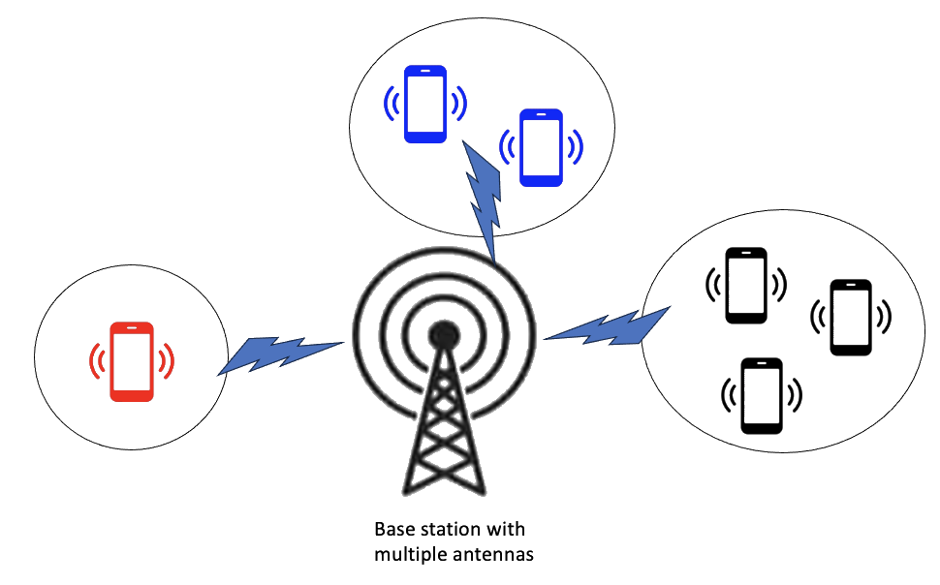



Adaptive Dynamic Coalition Structure Generation
Lucia Cipolina-Kun Ignacio Carlucho Kalesha Bullard
ALOE Workshop - Neurips 2023
Notes:
I would like to thank the ALOE workshop for this opportunity. I am Lucia Cipolina Kun, a final year PhD student at the University of Bristol and this is a joint work with my collaborators Ignacio Carlucho and Kalesha Bullard. This work is part of a bigger agenda of forming cooperative coalitions in populations of self-interested agents.
In this work, we consider humans and agents that need to form coalitions and dynamically update them as the environment changes.
We have an optimization problem at the population level, where self-interested agents cooperate to maximize the social optimum.

Slide 2
Motivation
Dynamic coalitions appears naturally in every day life
In different domains, humans and agents need to form coalitions and dynamically update them as the environment changes
Notes:
* AS A MOTIVATION
coalition formation appears naturally in many instances of our every day life.
PTY of the algorithm:
- Maximizing the– population- level welfare
- While preserving individual rationality
TODO:
- get rid of words -> every day lifeagents are self interest, need cooperation to maximize values --- Add pictures when coalitions are important – about 4 to 6 – showing coalitions in every day life. Traffic and clusters, and clusters of humans + robots, people talking in cellphones in groups. Why cooperative coalitions matters. Self-interested agents cooperating.
AT LEAST 2
- Factory setting where individuals are individually rational but need to cooperate
- Platooning for traffic - every single driver is interested on self destination – flow of traffic continues
- Communications - peoples with cellphones and groups

Slide 3



Motivation: dynamic coalitions appear naturally in every day life.
Notes:
- An example is connected vehicles, where rational agents want to minimize the time travel and can achieve so by forming coalitions of connected vehicles. In this settings, vehicles would like to pair with those who are closer to each other.
- Another example is the connection between communication devices to improve the efficiency of wireless transmissions. This is another setting where the pairing of devices is more beneficial than transmitting alone
- A last example is the collaboration between groups of humans and robots. While trying to reach their individual goals, each find cooperation beneficial to each other.

Slide 4
Motivation: dynamic coalitions appear naturally in every day life.
Notes:
- An example of coalition formation, are connected vehicles, where rational agents want to minimize the travel time by forming coalitions of connected vehicles. In this setting, vehicles would like to pair with those who are closer to each other to coordinate manouvers.

Slide 5
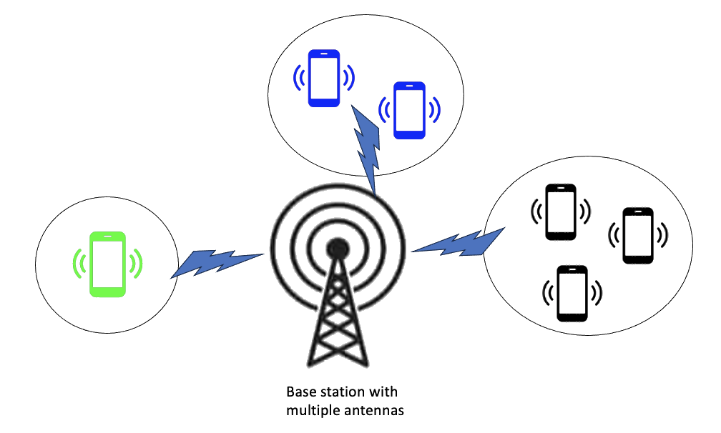
Motivation for Coalitions: Maximizing efficiency in wireless communications
Notes:
Another example is wireless communications, where devices pair with the ones closest to them to send signals more efficiently.

Slide 6
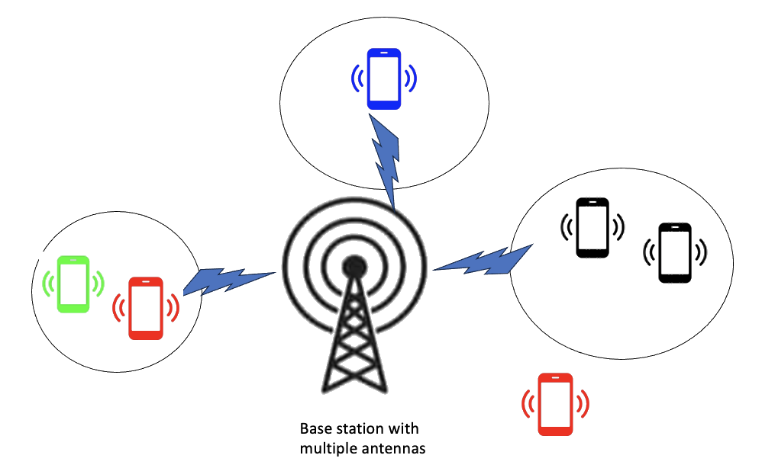
Motivation for Coalitions: Maximizing efficiency in wireless communications
Removed node
Moved node
Added node
Notes:
* As new devices come online, or change their locations while people move, the neighboring agents move, and the coalitions of devices need to be dynamically updated.

Slide 7
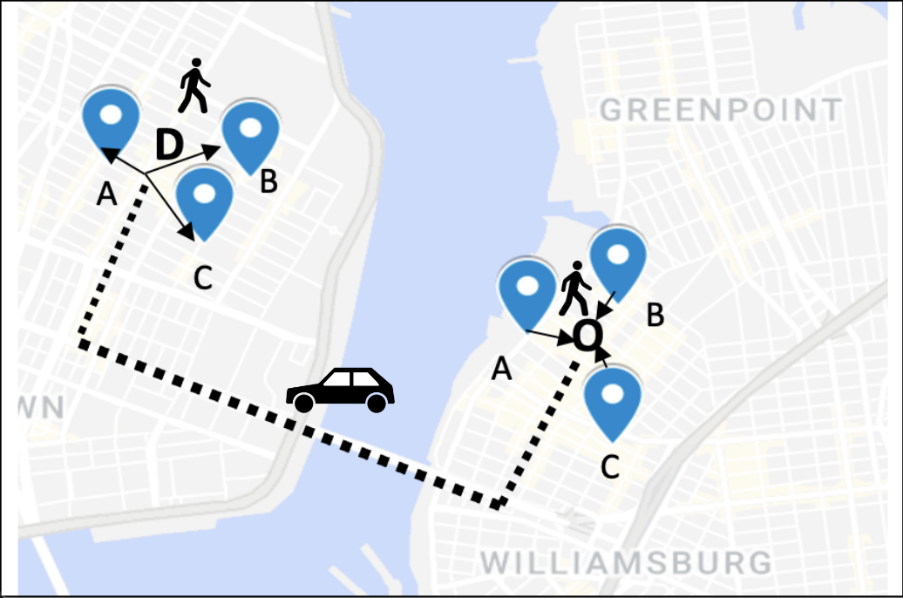
Motivation for Coalitions: Minimizing travel time in Ridesharing
Notes:
ANOTHER MOTIVATION IS RIDESHARING PLATFORMS
Where riders would like to share a car with others to minimize the travel cost

Slide 8
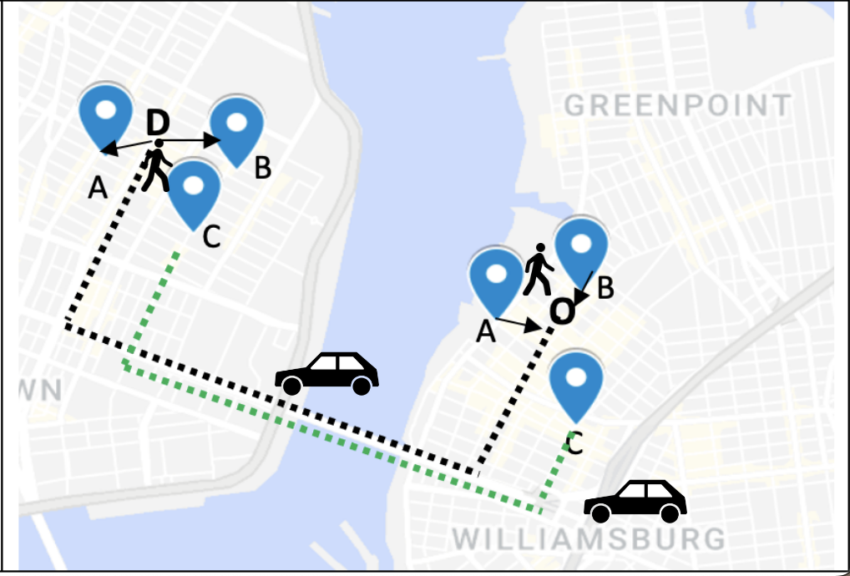

Motivation for Coalitions: Minimizing travel time in Ridesharing
Notes:
The interaction between users and the system is dynamically changing as more users are requesting the service or cancelling
This is another application of a changing environment where coalitions need to form and update on the fly.

Slide 9
Current Approaches for Dynamic Coalition Formation
Brute- force approaches
Exponential number computations for every environment.
Not generalizable to unseen games
Multi agent RL approaches
Non stationarity issue
Increases the complexity of the problem
Notes:
CURRENT APPROACHES FOR DYNAMIC COALITON FORMATION
Traditional brute-force approaches require an exhaustive search through the subset of agents, making it computationally intractable.
Additionally, it does not generalize to unseen environments, making it unsuitable for dynamic games.
2. Other multi-agent RL methods, introduce non-stationarity into the environment adding complexity to the problem
and introducing challenges for convergence.
- We solve the problem as a single agent RL, since it works with stationary dynamics and allows us to achieve generalization.

Slide 10




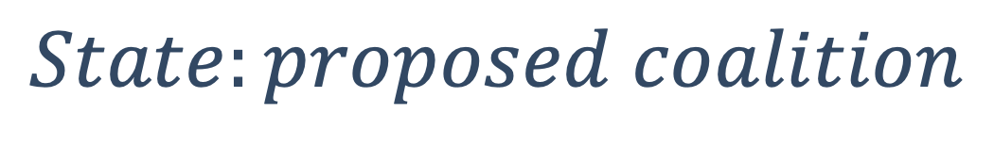
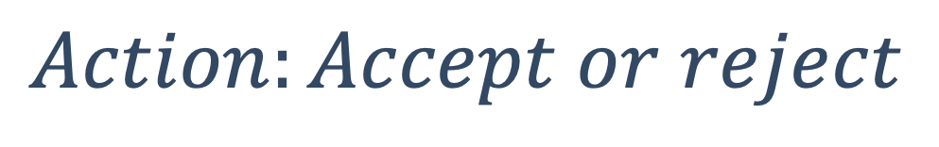
Our Approach
$$Action:Accept or reject$$
$$State:proposed coalition$$
+
Notes:
Our approach consists of a single-agent RL setting where an environment
select an agent
and makes a proposal for a coalition
the agent actions are to accept or reject the proposed coalition

Slide 11
Our Approach – the new state and reward
ACCEPT Reward = Value ( + ) - Value - ( )
REJECT: Reward = - Accept Reward
Notes:
If the agent accepts the proposal, the reward given is the difference between the value of the new coalition and the previous one. When agents accept coalitions with higher values, they will obtain a positive reward for accepting the right coalition.
If the agent reject the coalition proposal, the reward is the opposite, as we want to have positive rewards for rejecting LOWER valued coalitions
Because agents are trained independently - rewards are given individually to each agent

Slide 12
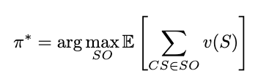
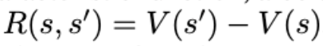
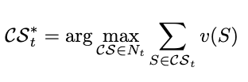
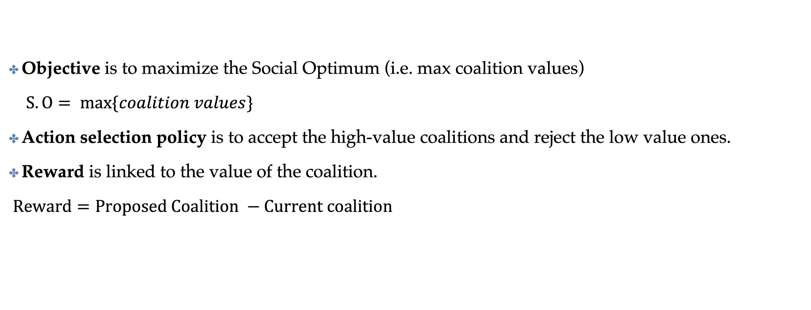
Our Approach
Objective is to maximize the Social Optimum (i.e. max coalition values)
$S.O= \max{\{coalition values\}}$
Action selection policy is to accept the high-value coalitions and reject the low value ones.
Reward is linked to the value of the coalition.
$Reward=Proposed Coalition −Current coalition$
Notes:
Reward function – sum of value of coalitions
Maximize the value of the coalitions → by maximizing …
TO SAY: The premise is that forming the coalitions than letting agents act individually. Reward: TO SAY: Such that it encourages selection of high value coalitions, achieving the Social Optimum.
Another animation: Assumption is that the coalition is greater than the sum of the individual result

Slide 13
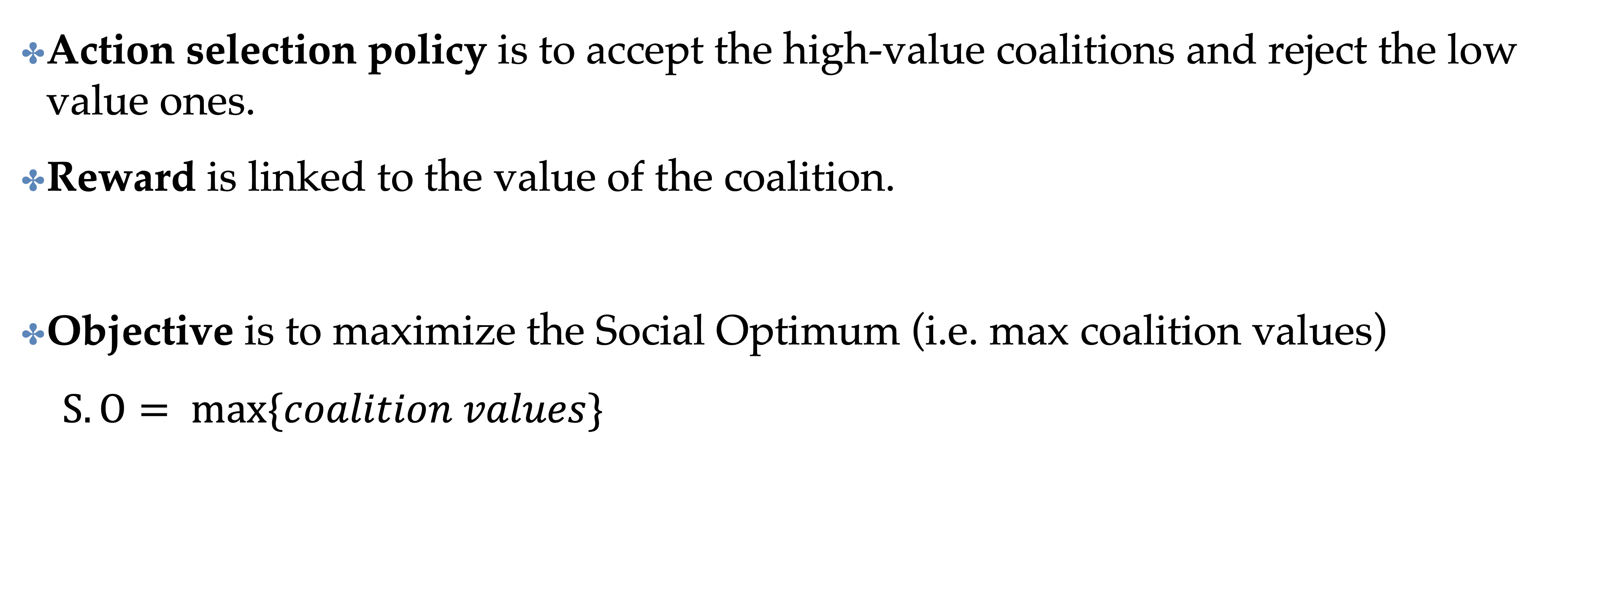
Our Approach
Action selection policy is to accept the high-value coalitions and reject the low value ones.
Reward is linked to the value of the coalition.
Objective is to maximize the Social Optimum (i.e. max coalition values)
$S.O= \max{\{coalition values\}}$
Notes:
OUR APPROACH
The action selection policy is trained to accept the high valued coalitions and reject the low valued ones
The reward guides the agents towards high valued coalitions As a result of this, our approach encourages the selection of high valued coalitions, achieving the social optimum.

Slide 14

Independent Learning Dynamics for a Game
+
+
+
time
Notes:
In this case, agent black is proposed to join a coalition with agent red and accepts
In the next step, the red agent is offered to join a coalition with agent black and accepts
Following, agent green is offered to join a coalition with agent black, but since black hasn’t accepted, the agent green remains alone.
The game converges when all agents agree to the same coalition

Slide 15
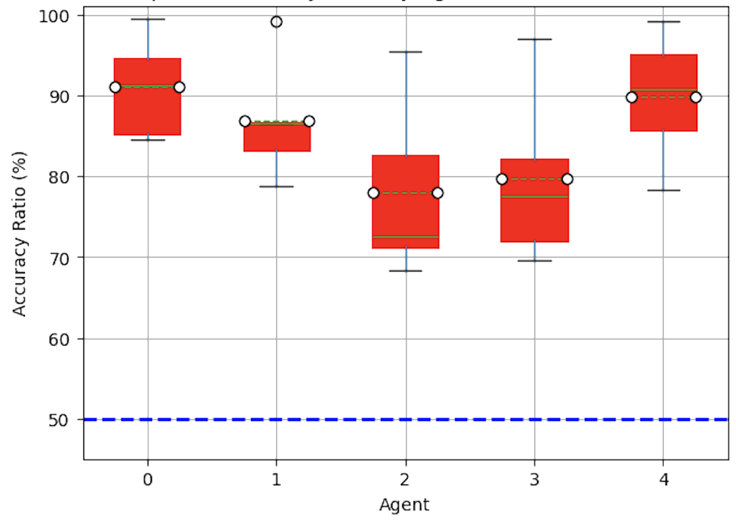
Aggregate Performance Per Agent -- Across Games
accuracy = # correct actions
————————-
# coalitions proposed
Random policy
Notes:
HERE WE SHOW THE RESULT OF TRAINING ACROSS GAMES
The results show the box plot of the Accuracy of of the agent's policies across tasks (trained with 1 seed). The dashed blue line represents the accuracy of a random policy. It is at 50% since we have only 2 actions.
On expectations, agents are well above the random policy across games, However, some agents have higher variance, which will be addressed in future work

Slide 16
Conclusions
We propose a method for forming coalitions in dynamic environments.
Single-agent RL method to more efficiently solve a computationally intractable problem.
Linear time convergence as opposed to exponential brute-force search.
Method significantly outperforms simple baselines in both simple and more complex classes of games.
Generalizes within in-distribution games.
Contact: Lucia.kun@Bristol.ac.uk
Notes:
CONCLUSIONS
We will be happy to talk about our work during the workshop day

Slide 17
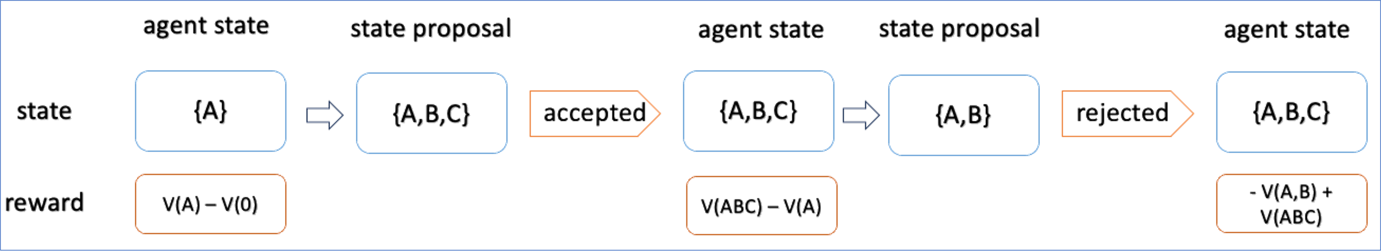
The deal-or-no deal game – Agent A
Notes:
THE DEAL OR NO DEAL GAME The environment selects an agent at random and proposes a coalition to join. The agent can accept the proposal and moves to the said coalition, or can reject it and stay in their current coalition.
The reward given is the difference between the value of the current coalition and the previous coalition.
If agents accept coalitions with higher value, the reward will be positive and if they reject coalitions with lower value, the reward will be positive as well. TODO: animate each column
Then the arrow, and the proposal, then animate accepted (or decline) – add the tree – add a box around accept, then appear the new current state. Say the reward
Explain the rewards
-→ Match with next slide

Slide 18
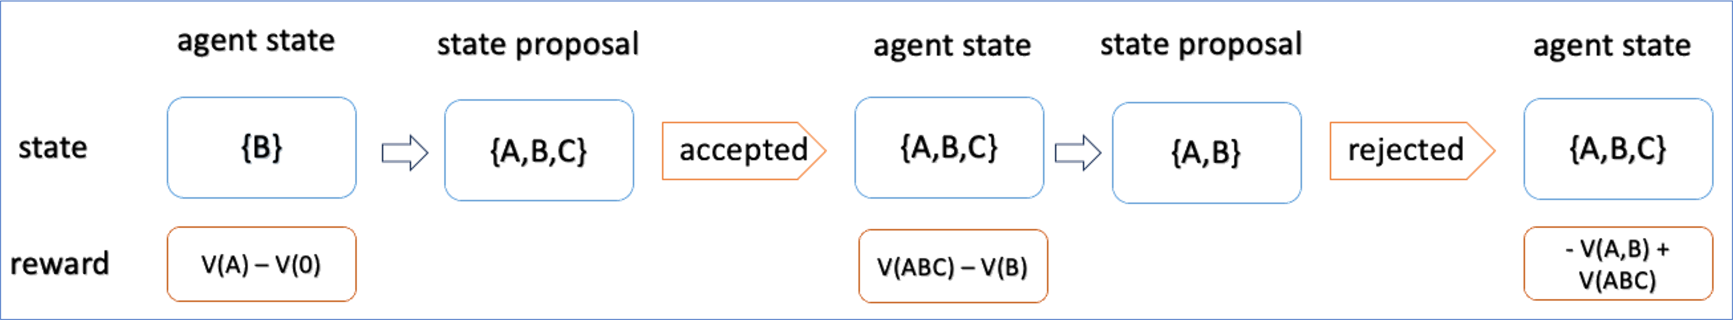
The deal-or-no deal game – Agent B
Notes:
The same game is repeated for agent B, as the starting agent Delete - SAY: this process is repeated individually for each agent

Slide 19
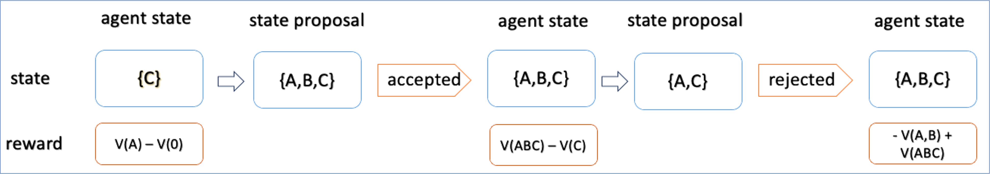
The deal-or-no deal game – Agent C
Notes:
And the same game is repeated for agent C In the end all agents will converge to the coalitions with higher values DELETE

Slide 20
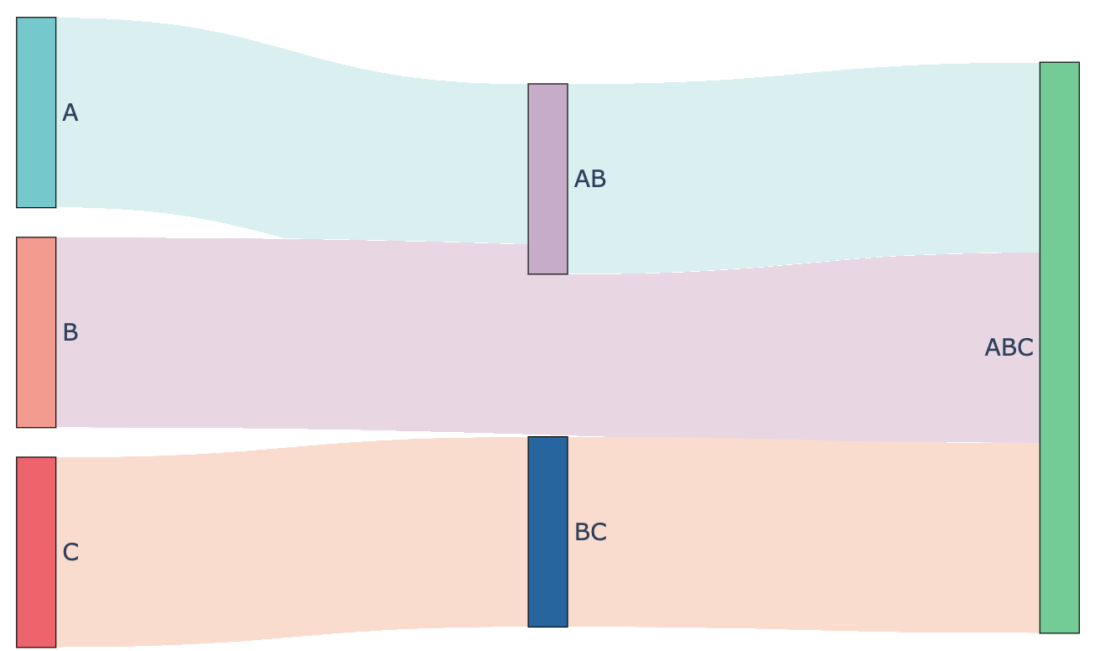
Independent Learning Dynamics for a Game
Notes:
MATCH with the previuos slide.
B and C can be moved to the right and up – later in time
AB – push them down and move them to the left Indepenedent learning dynamics highlight: because agents are trained independetly and rewards are given individually
- show the proposal then the next state - the next state is just
--→ BC → accept , because C accepts but B is not in the coalition.
.B - >. AB → accept → AB
A - > AB -> accept -> AB
They all get the proposal for ABC -→ then the world changes Animation of the arrows.
On top of the arrow (bottom accepted, rejected)

Slide 21
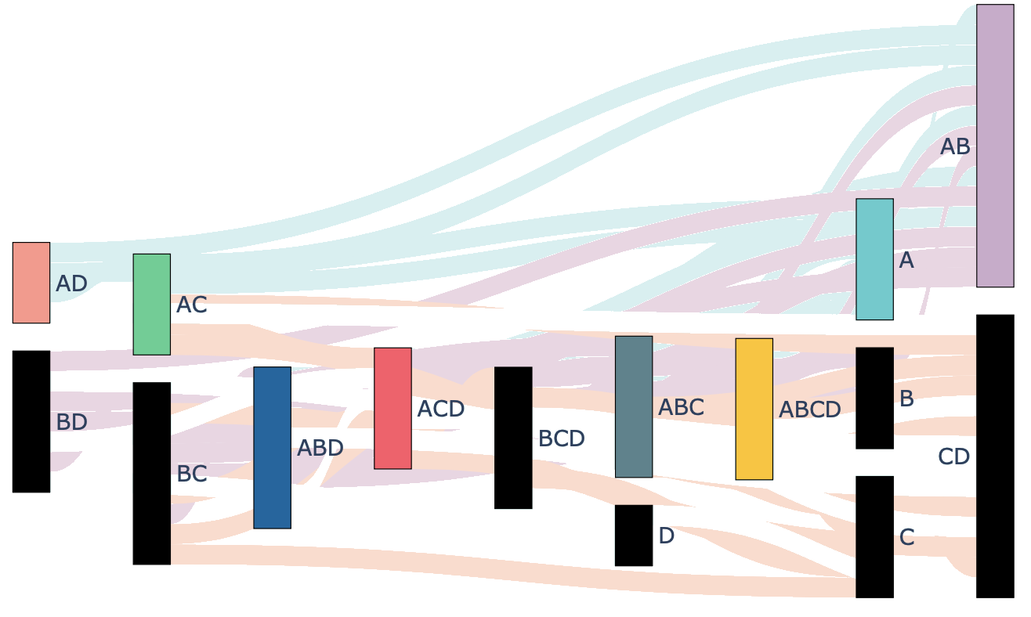
Dynamics for a coalition structure generation

Slide 22
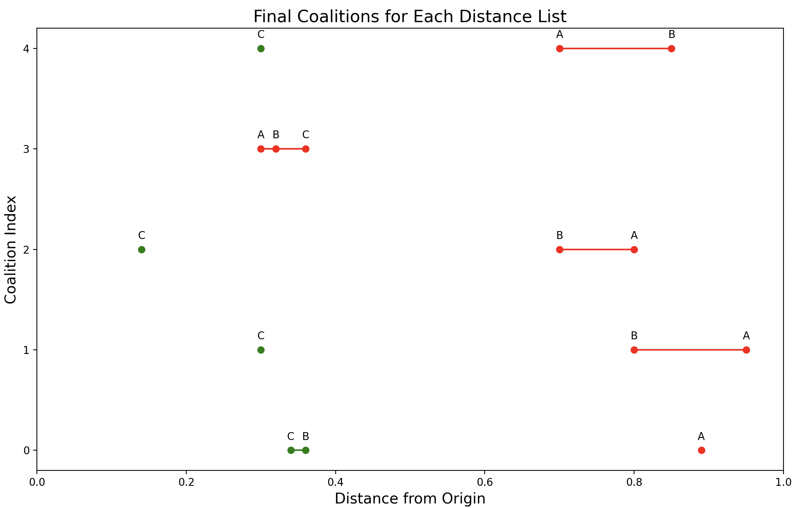
Generalization on 5 ridesharing games
Notes:
In -distribution generalization
TODO_ add the ridesharing CF simplified

